Slide 1




Slide 2


Get Started With React
Part 2

Slide 3

What to learn in this training
(Part 2)
useEffect hook
HTTP requests
fetching data with fetch API
React router
Controlled forms
SPA vs SSG vs SSR

Slide 4


React Hooks
We have already seen how to manipulate a component’s state with useState hook.
Now it’s time to discover another hook which is useEffect

Slide 5
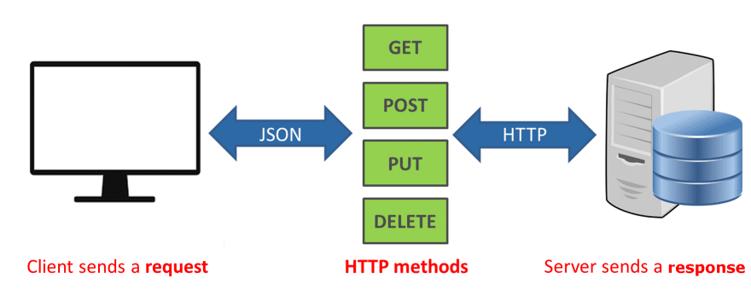
HTTP requests
An HTTP request is made by a client, to a named host, which is located on a server. The aim of the request is to access a resource on the server. To make the request, the client uses components of a URL (Uniform Resource Locator), which includes the information needed to access the resource.

Slide 6


React Router
React Router is the standard routing library for React that keeps your UI in sync with the URL. It has a simple API with powerful features like lazy code loading, dynamic route matching, and location transition handling built right in.

Slide 7
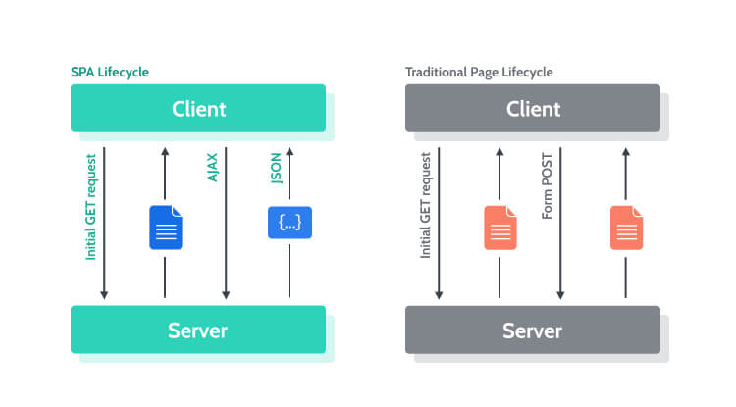
Single Page Applications
A web app implementation that loads only a single web document, and then updates the body content of that single document via JavaScript APIs such as XMLHttpRequest and Fetch when different content is to be shown.

Slide 8
SPA: Pros
While the initial load maybe longer, once the application has fully loaded, there will not be additional loading required.
Good choice for dynamic experiences where teams need a customized feeling to their user experience
Teams have a lot of control over their architectures and can make use of modern web frameworks

Slide 9
SPA: Cons
As the application grows in size and complexity, it can severely impact the initial load time which can lead to a deterioration of user experience.
Maintaining good SEO is nearly impossible because of load times and lack of initial content on the HTML.
Challenges with the SPA approach require workarounds that can be costly and time-consuming.

Slide 10
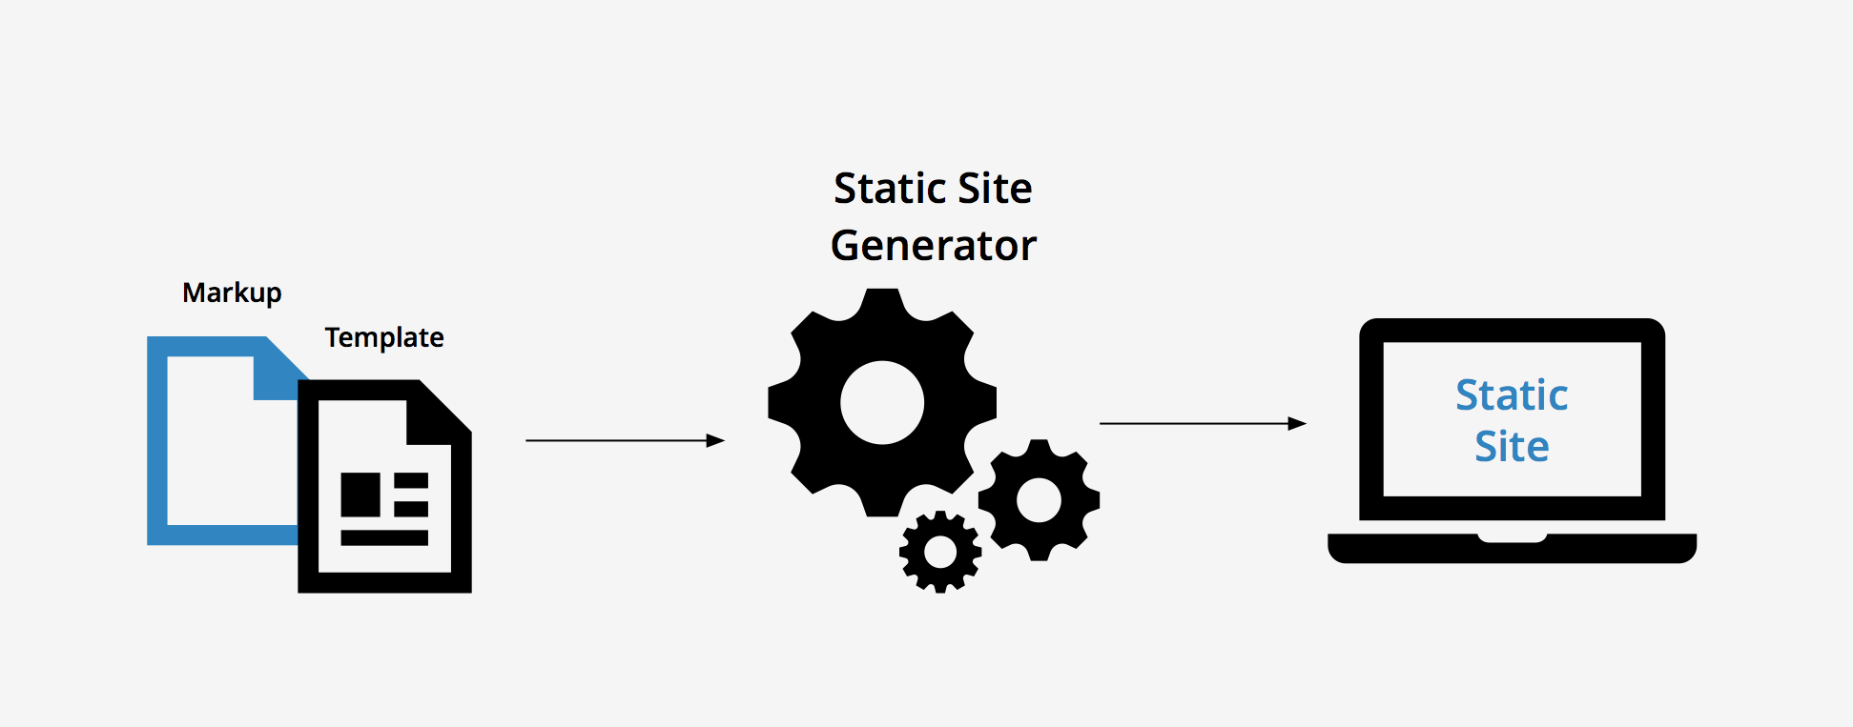
Static Site Generators
A software application that creates HTML pages from templates or components and a given content source. Static site generators are an alternative to database-driven content management systems, such as WordPress and Drupal.

Slide 11
SSG: Pros
Easy to create decoupled architecture with multiple content sources
Fast page load times due to much of the content being pre-rendered and the static nature of the content
Better for SEO
Easily scalable infrastructure that allows the project to grow organically

Slide 12

SSG: Cons
Personalization and dynamic content require workarounds or additional services.
When content does change, you must rebuild the site in order to have these changes reflected on the site.

Slide 13


Server Side Rendering
An application's ability to convert HTML files on the server into a fully rendered HTML page for the client. The web browser submits a request for information from the server, which instantly responds by sending a fully rendered page to the client.

Slide 14

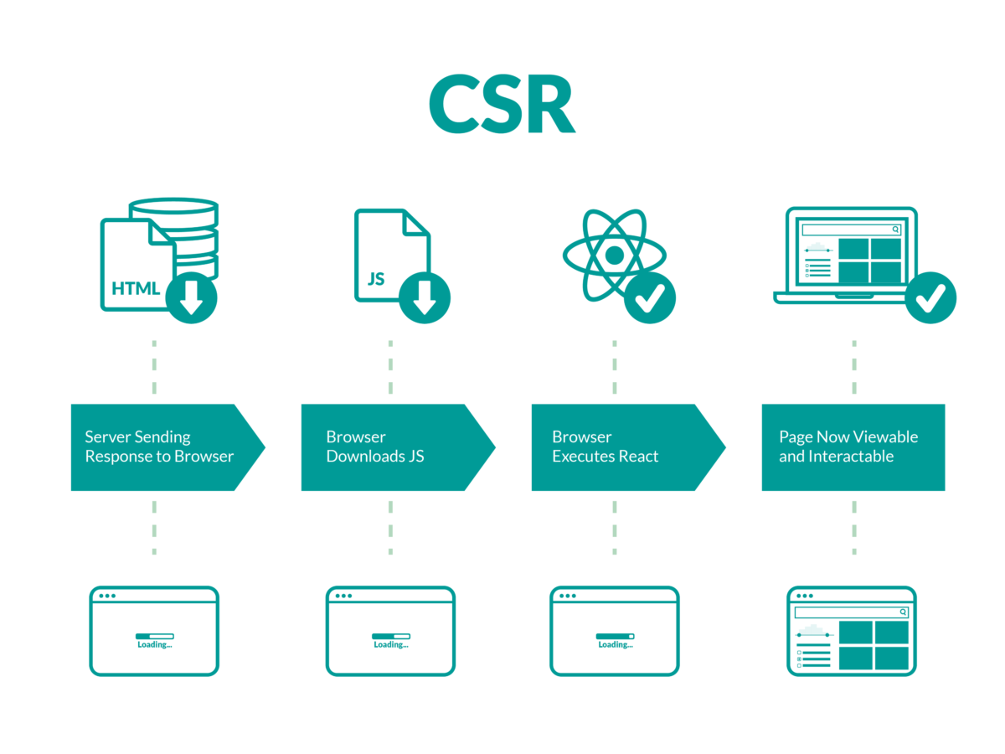
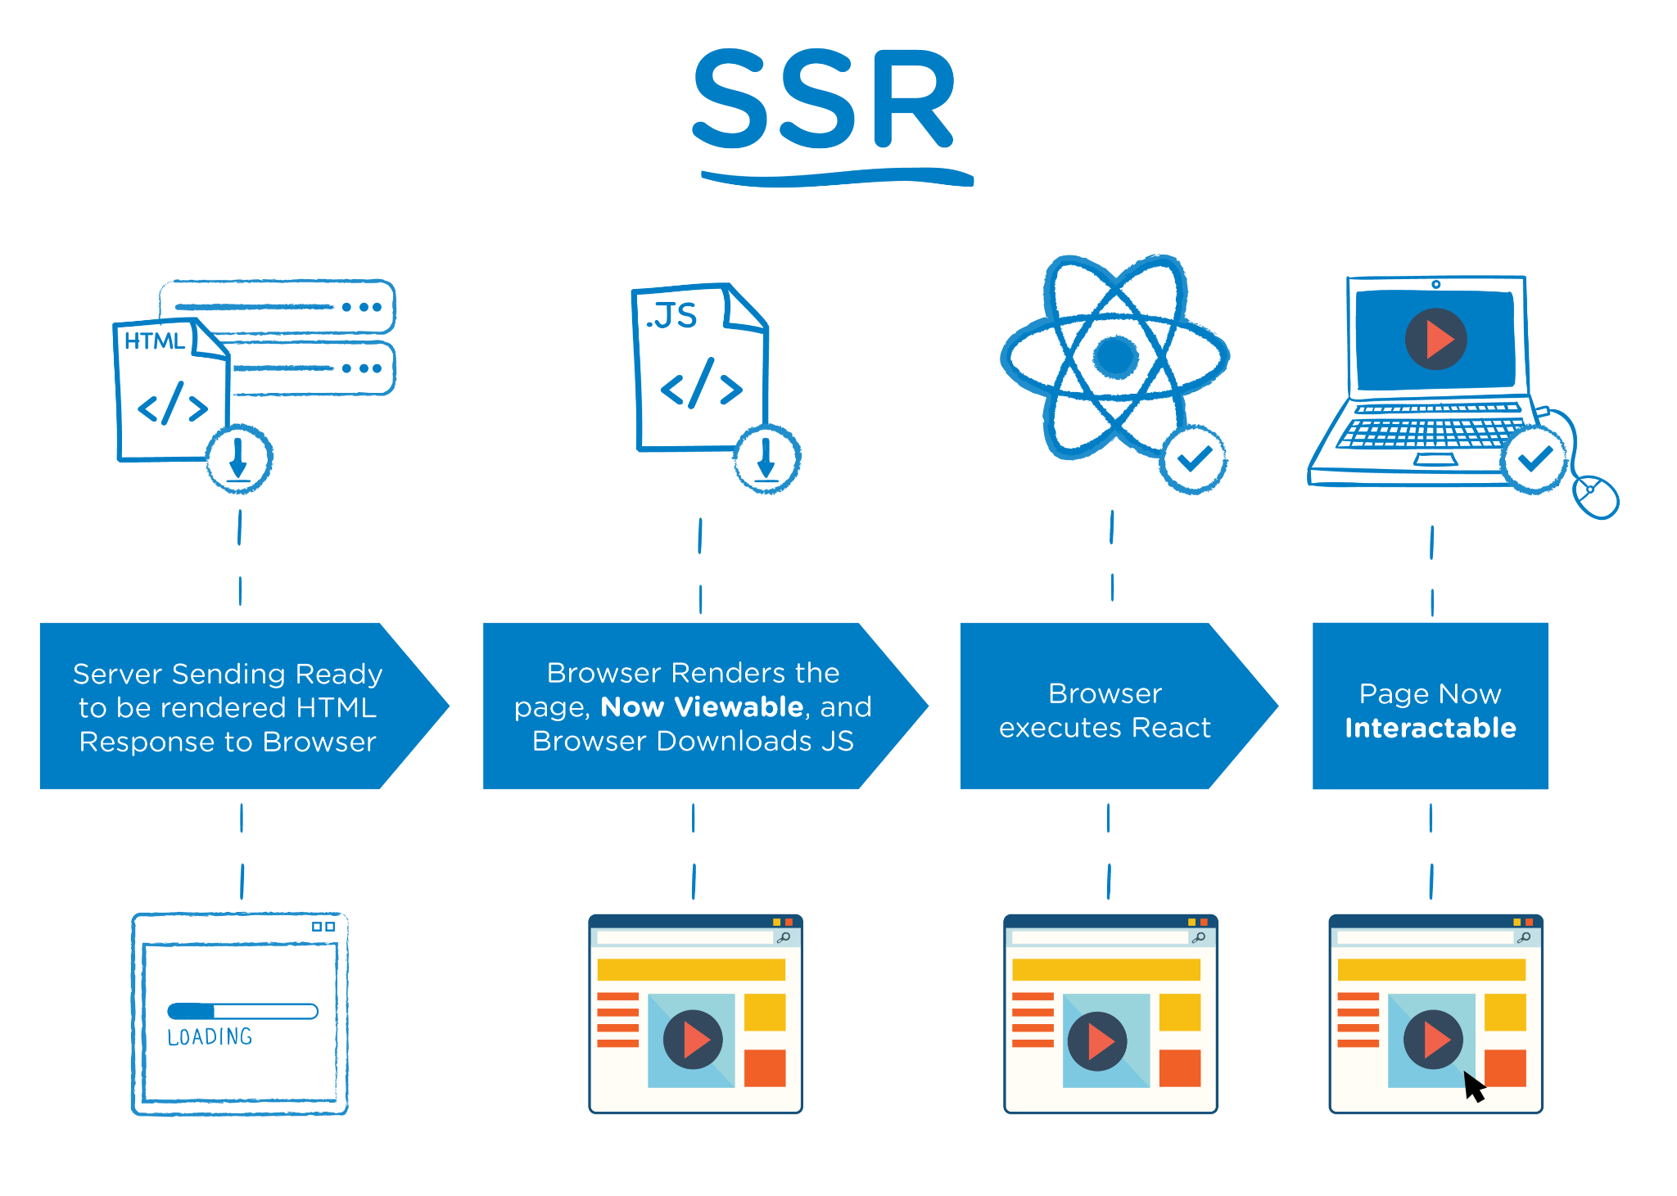
CSR vs SSR

Slide 15
SSR: Pros
SSR enables teams to create dynamic, personalized content experiences without labor-intensive workarounds
Changes to content are displayed instantaneously unlike SSGs where teams must rebuild the site to see the changes to the content
SSR sites are client agnostic, different from SPAs where clients can determine page loading time or quality
It is easier to rank well for SEO with SSRs than SPAs, while still providing personalized experiences

Slide 16
SSR: Cons
SSRs typically require more API calls to the server
SSRs by default are often slower than SPAs and SSGs

Slide 17
What’s next ?
Discover React more (state management, axios in react, refs…)
Practise
Learn a CSS framework/library
Learn more about SSR & SSG technologies related React
Work on real projects
And most importantly … Have fun coding !

Slide 18


That’s all for today

